Slide 1


FACE RECOGNITION ATTAENDANCE SYSTEM
Team Members :
24kb1a04xx - name
24kb1a05xx - name
24kb1a05xx - name

Slide 2
Introduction:
Attendance systems are essential for managing records.
Manual attendance is time-consuming and error-prone.
Face Recognition brings automation, security, and speed.

Slide 3
Previous Attendance Systems:
Manual Attendance (Paper registers):
Time-consuming
Easy to fake proxy attendance
Biometric Attendance (Fingerprint scanners):
Physical contact needed
Not hygienic (post COVID-19)
Card Swipe Attendance:
Cards can be lost or misused
Costly to maintain

Slide 4
Drawbacks of Previous Systems:
Proxy Attendance still possible
High maintenance costs
Requires physical interaction
Inconvenient during pandemics
Error-prone data entry

Slide 5
Objective :
Build a Face Recognition Attendance System
Use only C language and Data Structures (Arrays, Linked Lists, Trees)
Simulate Face Matching Logic using structures

Slide 6
System Overview :
Capture and Store facial feature data (simulated)
Search and Match using Data Structures
Mark Attendance based on successful match
Store Attendance Records

Slide 7
Technologies and Tools :
Language: C
Concepts: Arrays, Linked Lists, Trees
Storage: File Handling for saving records
Simulated Face Data: Numeric Codes (for simplicity)

Slide 8
Working Flow :
Enroll Students (Face data registration)
Capture Face Data (input simulation)
Compare Data (Search in database)
Mark Attendance (Present/Absent)
Save records into a file

Slide 9
Modules in Project :
Enrollment Module (Add student data)
Recognition Module (Match faces)
Attendance Marking Module (Update records)
Database Management (Store in files)

Slide 10
Advantages of Our System :
Lightweight and fast (because of C)
No external libraries needed
Easy to understand and modify
Efficient use of Data Structures for quick search
Good for low-resource devices

Slide 11
Challenges :
Face Recognition logic is simulated, not real images
Matching accuracy depends on input data quality
Real-world deployment would need real image processing libraries

Slide 12
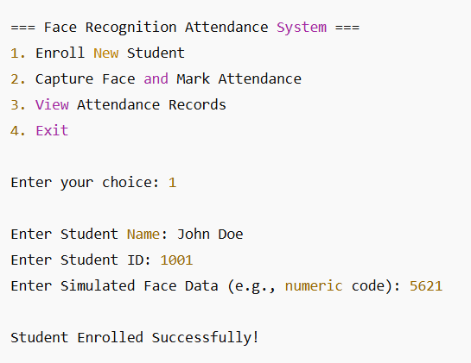
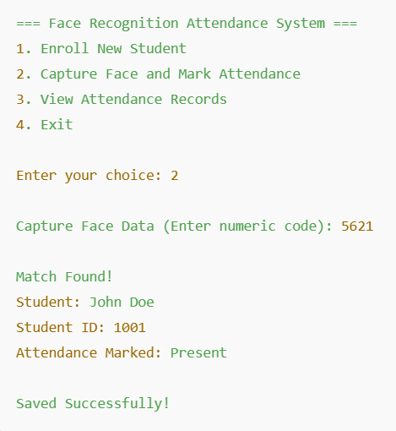
Output Images :

Slide 13
Conclusion :
C and Data Structures provide a strong base for face recognition logic
Our system improves accuracy, speed, and reduces human errors
Big step toward smart attendance management without costly systems

Slide 14
Thank You 🙏

